Slide 1
SSL/TLS

Slide 2
What is SSL / TLS?
  De facto standard for Internet security
  “The primary goal of the TLS protocol is to provide privacy and data integrity between two communicating applications”
  In practice, used to protect information transmitted between browsers and Web servers
Based on Secure Sockets Layers protocol, ver 3.0
  Same protocol design, different algorithms
Deployed in nearly every web browser

Slide 3
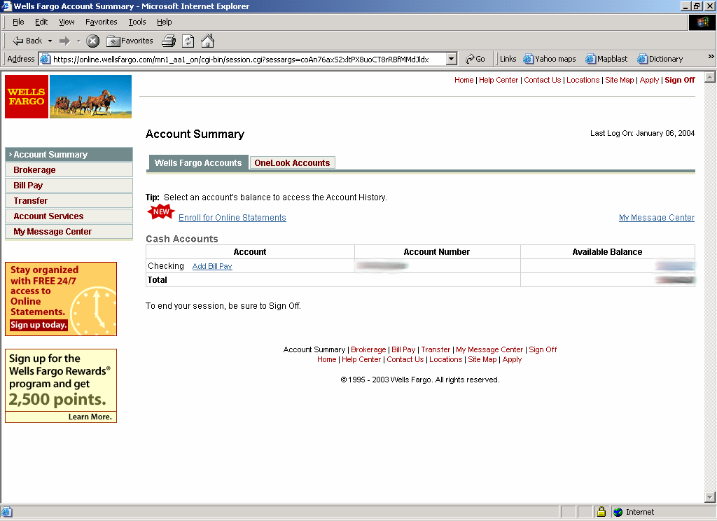
SSL / TLS in the Real World

Slide 4
History of the Protocol
SSL 1.0
  Internal Netscape design, early 1994?
  Lost in the mists of time
SSL 2.0
  Published by Netscape, November 1994
  Badly broken
SSL 3.0
  Designed by Netscape and Paul Kocher, November 1996
TLS 1.0
  Internet standard based on SSL 3.0, January 1999
  Not interoperable with SSL 3.0

Slide 5
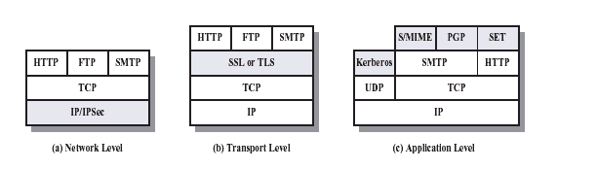
Layers of Security

Slide 6
Overview
Establish a session
  Agree on algorithms
  Share secrets
  Perform authentication
Transfer application data
  Ensure privacy and integrity

Slide 7
Architecture
Record Protocol to transfer application and TLS information
A session is established using a Handshake Protocol
Handshake Protocol
Change
Cipher Spec
Alert Protocol
TLS Record Protocol
Notes:
Operational and pending states

Slide 8
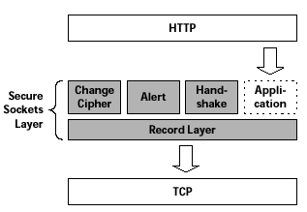
Architecure (cont’d)
INITIALIZES SECURE
COMMUNICATION
ERROR HANDLING
HANDLES COMMUNICATION
WITH THE APPLICATION
Protocols
INITIALIZES COMMUNCATION
BETWEEN CLIENT & SERVER
HANDLES DATA
COMPRESSION

Slide 9
Handshake
Negotiate Cipher-Suite Algorithms
  Symmetric cipher to use
  Key exchange method
  Message digest function
Establish and share master secret
Optionally authenticate server and/or client
Notes:
Encryption mac key exchange
Des/3des/des40 md5, sha1, none rsa, dh
rc2 rc4
idea
none

Slide 10
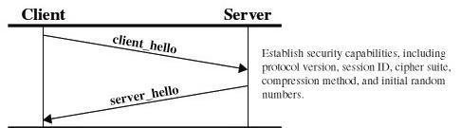
Handshake Protocol
The Handshake Protocol allows the server and client to
authenticate each other and negotiate an encryption
and MAC
First Phase

Slide 11
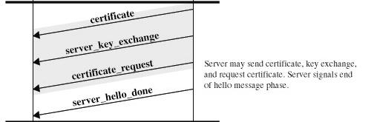
Second Phase

Slide 12
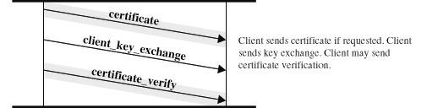
Third Phase

Slide 13
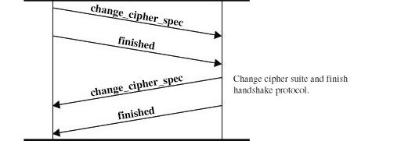
Fourth Phrase

Slide 14
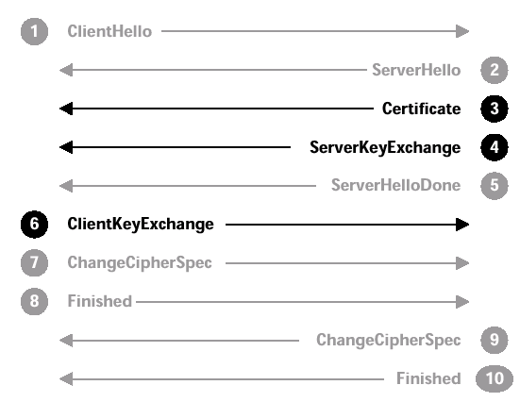
SSL Messages
CLIENT SIDE
SERVER SIDE
OFFER CIPHER SUITE
MENU TO SERVER
SELECT A CIPHER SUITE
SEND CERTIFICATE AND
CHAIN TO CA ROOT
SEND PUBLIC KEY TO
ENCRYPT SYMM KEY
SEND ENCRYPTED
SYMMETRIC KEY
SERVER NEGOTIATION
FINISHED
ACTIVATE
ENCRYPTION
CLIENT PORTION
DONE
( SERVER CHECKS OPTIONS )
ACTIVATESERVER
ENCRYPTION
( CLIENT CHECKS OPTIONS )
SERVER PORTION
DONE
NOW THE PARTIES CAN USE SYMMETRIC ENCRYPTION
SOURCE: THOMAS, SSL AND TLS ESSENTIALS
Notes:
52

Slide 15
Client Hello
  Protocol version
    SSLv3(major=3, minor=0)
    TLS (major=3, minor=1)
  Random Number
    32 bytes
    First 4 bytes, time of the day in seconds, other 28 bytes random
    Prevents replay attack
  Session ID
    32 bytes – indicates the use of previous cryptographic material
  Compression algorithm
Notes:
Server “Hello Request”- ask client to restart
hello includes some random data for creating the master secret

Slide 16
Client Hello - Cipher Suites
INITIAL (NULL) CIPHER SUITE
SSL_NULL_WITH_NULL_NULL = { 0, 0 }
SSL_RSA_WITH_NULL_MD5 = { 0, 1 }
SSL_RSA_WITH_NULL_SHA = { 0, 2 }
SSL_RSA_EXPORT_WITH_RC4_40_MD5 = { 0, 3 }
SSL_RSA_WITH_RC4_128_MD5 = { 0, 4 }
SSL_RSA_WITH_RC4_128_SHA = { 0, 5 }
SSL_RSA_EXPORT_WITH_RC2_CBC_40_MD5 = { 0, 6 }
SSL_RSA_WITH_IDEA_CBC_SHA = { 0, 7 }
SSL_RSA_EXPORT_WITH_DES40_CBC_SHA = { 0, 8 }
SSL_RSA_WITH_DES_CBC_SHA = { 0, 9 }
SSL_RSA_WITH_3DES_EDE_CBC_SHA = { 0, 10 }
PUBLIC-KEY
ALGORITHM
SYMMETRIC
ALGORITHM
HASH
ALGORITHM
CIPHER SUITE CODES USED
IN SSL MESSAGES
Notes:
52

Slide 17
Server Hello
Version
Random Number
Session ID
  Provided to the client for later resumption of the session
Cipher suite
  Usually picks client’s best preference – No obligation
Compression method

Slide 18
Certificates
Sequence of X.509 certificates
  Server’s, CA’s, …
X.509 Certificate associates public key with identity
Certification Authority (CA) creates certificate
  Adheres to policies and verifies identity
  Signs certificate
User of Certificate must ensure it is valid
Notes:
PKCS standards from RSA for RSA certificates
PKCS #10 cert requests
PKCS #9 cert attributes
PKCS #7 cert chain format
application/x-pkcs7-mime
used to load CA chain into browser

Slide 19
Validating a Certificate
Must recognize accepted CA in certificate chain
  One CA may issue certificate for another CA
Must verify that certificate has not been revoked
  CA publishes Certificate Revocation List (CRL)

Slide 20
Client Key Exchange
Premaster secret
  Created by client; used to “seed” calculation of encryption parameters
  2 bytes of SSL version + 46 random bytes
  Sent encrypted to server using server’s public key

Slide 21
Change Cipher Spec &
Finished Messages
Change Cipher Spec
  Switch to newly negotiated algorithms and key material
Finished
  First message encrypted with new crypto parameters
  Digest of negotiated master secret, the ensemble of handshake messages

Slide 22
SSL Encryption
Master secret
  Generated by both parties from premaster secret and random values generated by both client and server
Key material
  Generated from the master secret and shared random values
Encryption keys
  Extracted from the key material
Notes:
52

Slide 23
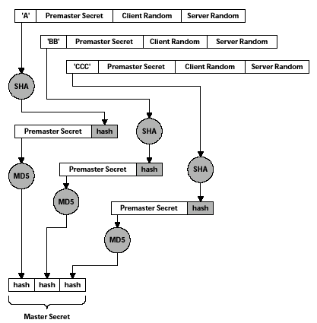
Generating the Master Secret
SERVER’S PUBLIC KEY
IS SENT BY SERVER IN
ServerKeyExchange
CLIENT GENERATES THE
PREMASTER SECRET
ENCRYPTS WITH PUBLIC
KEY OF SERVER
CLIENT SENDS PREMASTER
SECRET IN ClientKeyExchange
SENT BY SERVER
IN ServerHello
SENT BY CLIENT
IN ClientHello
MASTER SECRET IS 3 MD5
HASHES CONCATENATED
TOGETHER = 384 BITS
SOURCE: THOMAS, SSL AND TLS ESSENTIALS
Notes:
52

Slide 24
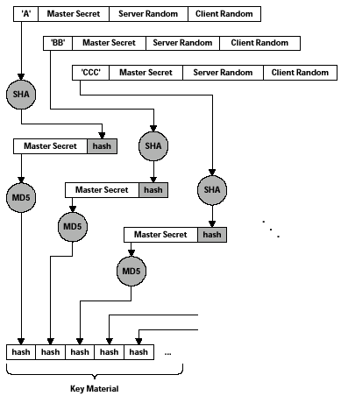
Generation of Key Material
JUST LIKE FORMING
THE MASTER SECRET
EXCEPT THE MASTER
SECRET IS USED HERE
INSTEAD OF THE
PREMASTER SECRET
. . .
SOURCE: THOMAS, SSL AND TLS ESSENTIALS
Notes:
52

Slide 25
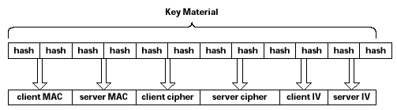
Obtaining Keys from the Key Material
SECRET VALUES
INCLUDED IN MESSAGE
AUTHENTICATION CODES
SYMMETRIC KEYS
INITIALIZATION VECTORS
FOR DES CBC ENCRYPTION
SOURCE: THOMAS, SSL AND TLS ESSENTIALS
Notes:
52

Slide 26
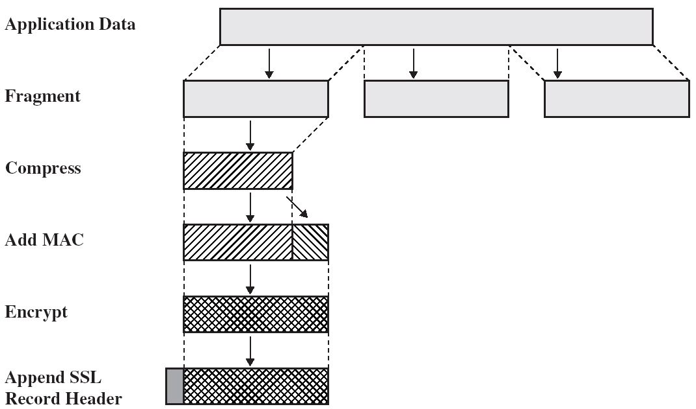
SSL Record Protocol
Notes:
52

Slide 27
Record Header
Three pieces of information
  Content type
    Application data
    Alert
    Handshake
    Change_cipher_spec
  Content length
    Suggests when to start processing
  SSL version
    Redundant check for version agreement

Slide 28
Protocol (cont’d)
Max. record length 2^{14 –} 1
MAC
  Data
  Headers
  Sequence number
    To prevent replay and reordering attack
    Not included in the record

Slide 29
Alerts
Alert the other side of exceptions
  Different levels
  Terminate and session cannot be resumed

Slide 30
SSL Sessions
Sessions vs. Connections
  Multiple connections within a sessions
  One negotiation/session
Session Resumption
  Through session IDs
  Clients use server IP address or name as index
  Servers use the session IDs provide by the clients
  Use of random numbers in resumed session key calculation ensures different keys
Session Re-handshake
  Client can initiate a new handshake within a session
  Use of Server Gated Cryptography (SGC) for added security

Slide 31
SSL Overhead
2-10 times slower than a TCP session
Where do we lose time
  Handshake phase
    Client does public-key encryption
    Server does private-key encryption (still public-key cryptography)
    Usually clients have to wait on servers to finish
  Data Transfer phase
    Symmetric key encryption

Slide 32
SSL Applications
HTTP – original application
Secure mail
  Server to client connection
  SMTP/SSL?
Telnet, ftp ..
Resources: http://www.openssl.org/related/apps.html

